Slide 1
Real time two stage Image Classification Model for Autonomous Vehicle June 19th, 2021
REVA Academy for Corporate Excellence (RACE)
Bharadwaz S
AI01
R20MTA10
www.reva.edu.in

Slide 2
AGENDA
Introduction
Problem Statement & Objectives
Proposed Solution
Data Collection
Object Detection
Object Classification
Deployment
Conclusion & Future Recommendation

Slide 3
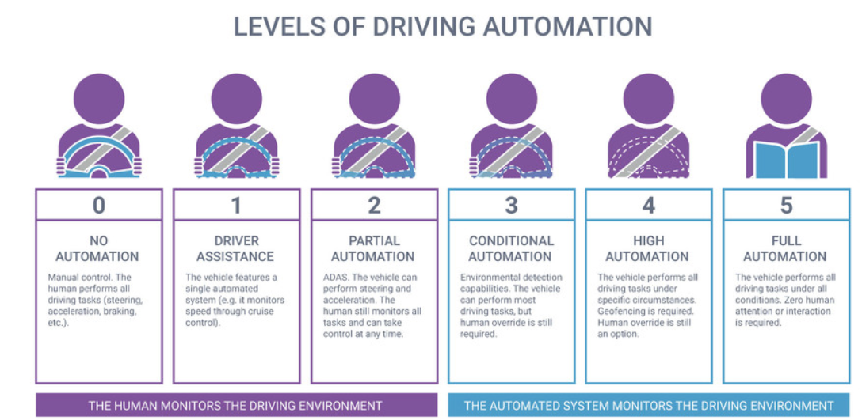
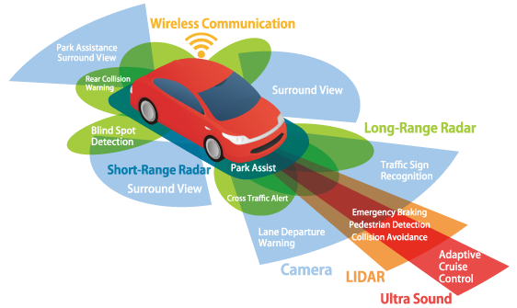
Introduction
Ref: www.landmarkdividend.com
Self-driving cars requires lot of training and infrastructure as they are supposed to move in any location whereas Autonomous vehicle with little amount of training can be used to accomplish most of the tasks in a constrained path
REVA Academy for Corporate Excellence (RACE)

Slide 4
Problem Statement & Objective
Problem Statement: In a constrained path, detect objects and classify the objects into two classes – Human/Non-Human
Objective: Build a two-stage object detection and classification model using simple background subtraction method and pre-trained models respectively
Scope:
RACE Building
Single camera to capture the Images
Day time Images
Step wise Processing
Two classes – Human or Non Human
REVA Academy for Corporate Excellence (RACE)

Slide 5
Proposed Solution
Reference Images
Capture Video
Split it into frames
Select Frames for every 2 sec or 2 Ft or both
Compare the image with reference image
If any object is detected, go to next step. If not select frames
Use pre-trained model to detect whether the object is human or not
Provide Feedback to Vehicle
Vehicle
REVA Academy for Corporate Excellence (RACE)

Slide 6
Data Collection
Background images are captured beforehand which are the ideal state images with no objects
Real time images are collected using single monocular camera
Video is split into frames and selected based on conditions to perform background subtraction
For every 2 sec (OR)
For every 2 Feet (OR)
Both the conditions
REVA Academy for Corporate Excellence (RACE)

Slide 7
Object Detection
Image 1 (Background Image)
Convert to Gray Scale
Blur the Image
Convert to Binary using Threshold
Perform Dilation
Output
Subtraction
Image 2
(Real-time Image)
Convert to Gray Scale
Blur the Image
Object Classification
REVA Academy for Corporate Excellence (RACE)

Slide 8
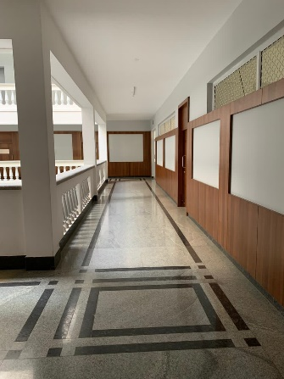
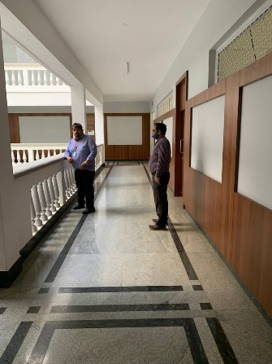
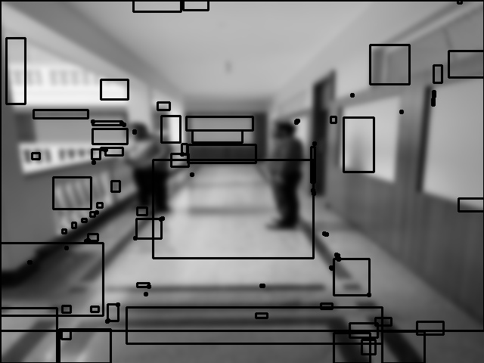
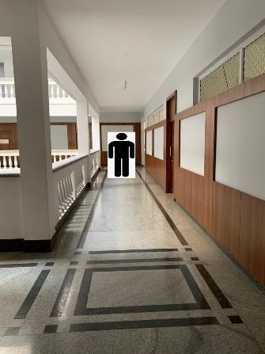
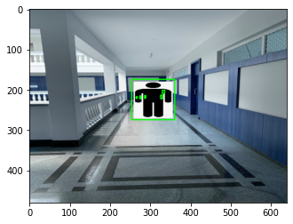
Back Ground Subtraction – Experiment 1
Background Image
Test Image with captured location moved ahead
Output after Image subtraction
Background Image
Test Image with Captured location as same as Background Image
Output after Image subtraction
The above experiment shows that any slightest change in the capturing distance, background subtraction will yield erroneous results
REVA Academy for Corporate Excellence (RACE)

Slide 9
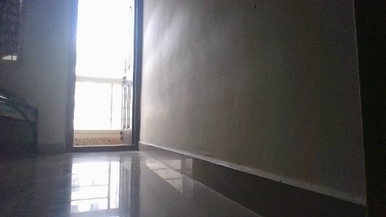
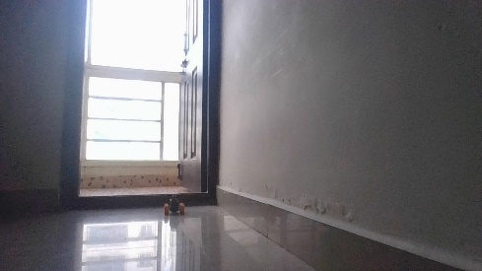
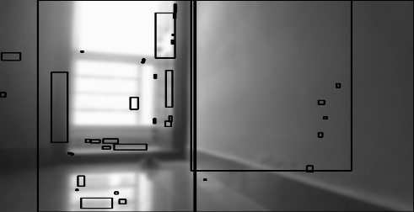
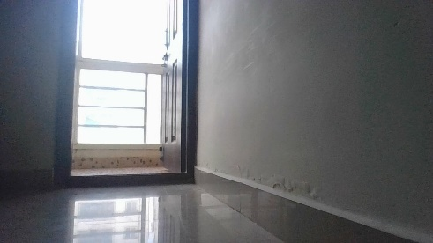

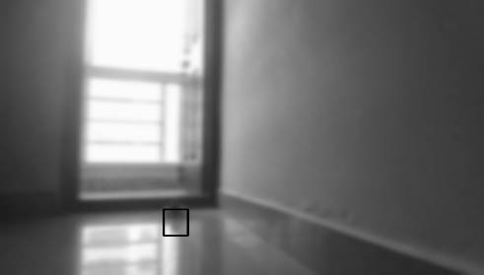
Back Ground Subtraction – Experiment 2
Background Image
Test Image with captured location moved ahead
Output after Image subtraction
Background Image
Test Image with Captured location as same as Background Image
Output after Image subtraction
From both experiments, implementation of background subtraction method would be not feasible due to huge number of images that need to collected and processed
REVA Academy for Corporate Excellence (RACE)

Slide 10

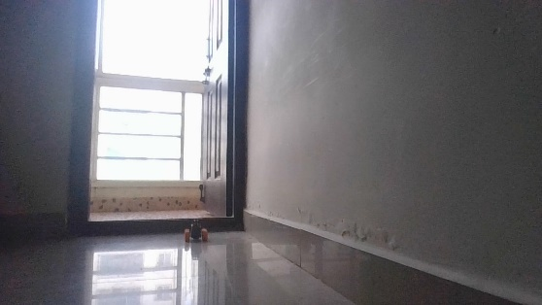



Back Ground Subtraction – Experiment 2
REVA Academy for Corporate Excellence (RACE)

Slide 11
Object Classification using Mobile Net
REVA Academy for Corporate Excellence (RACE)

Slide 12
Q&A?
REVA Academy for Corporate Excellence (RACE)

